Slide 1


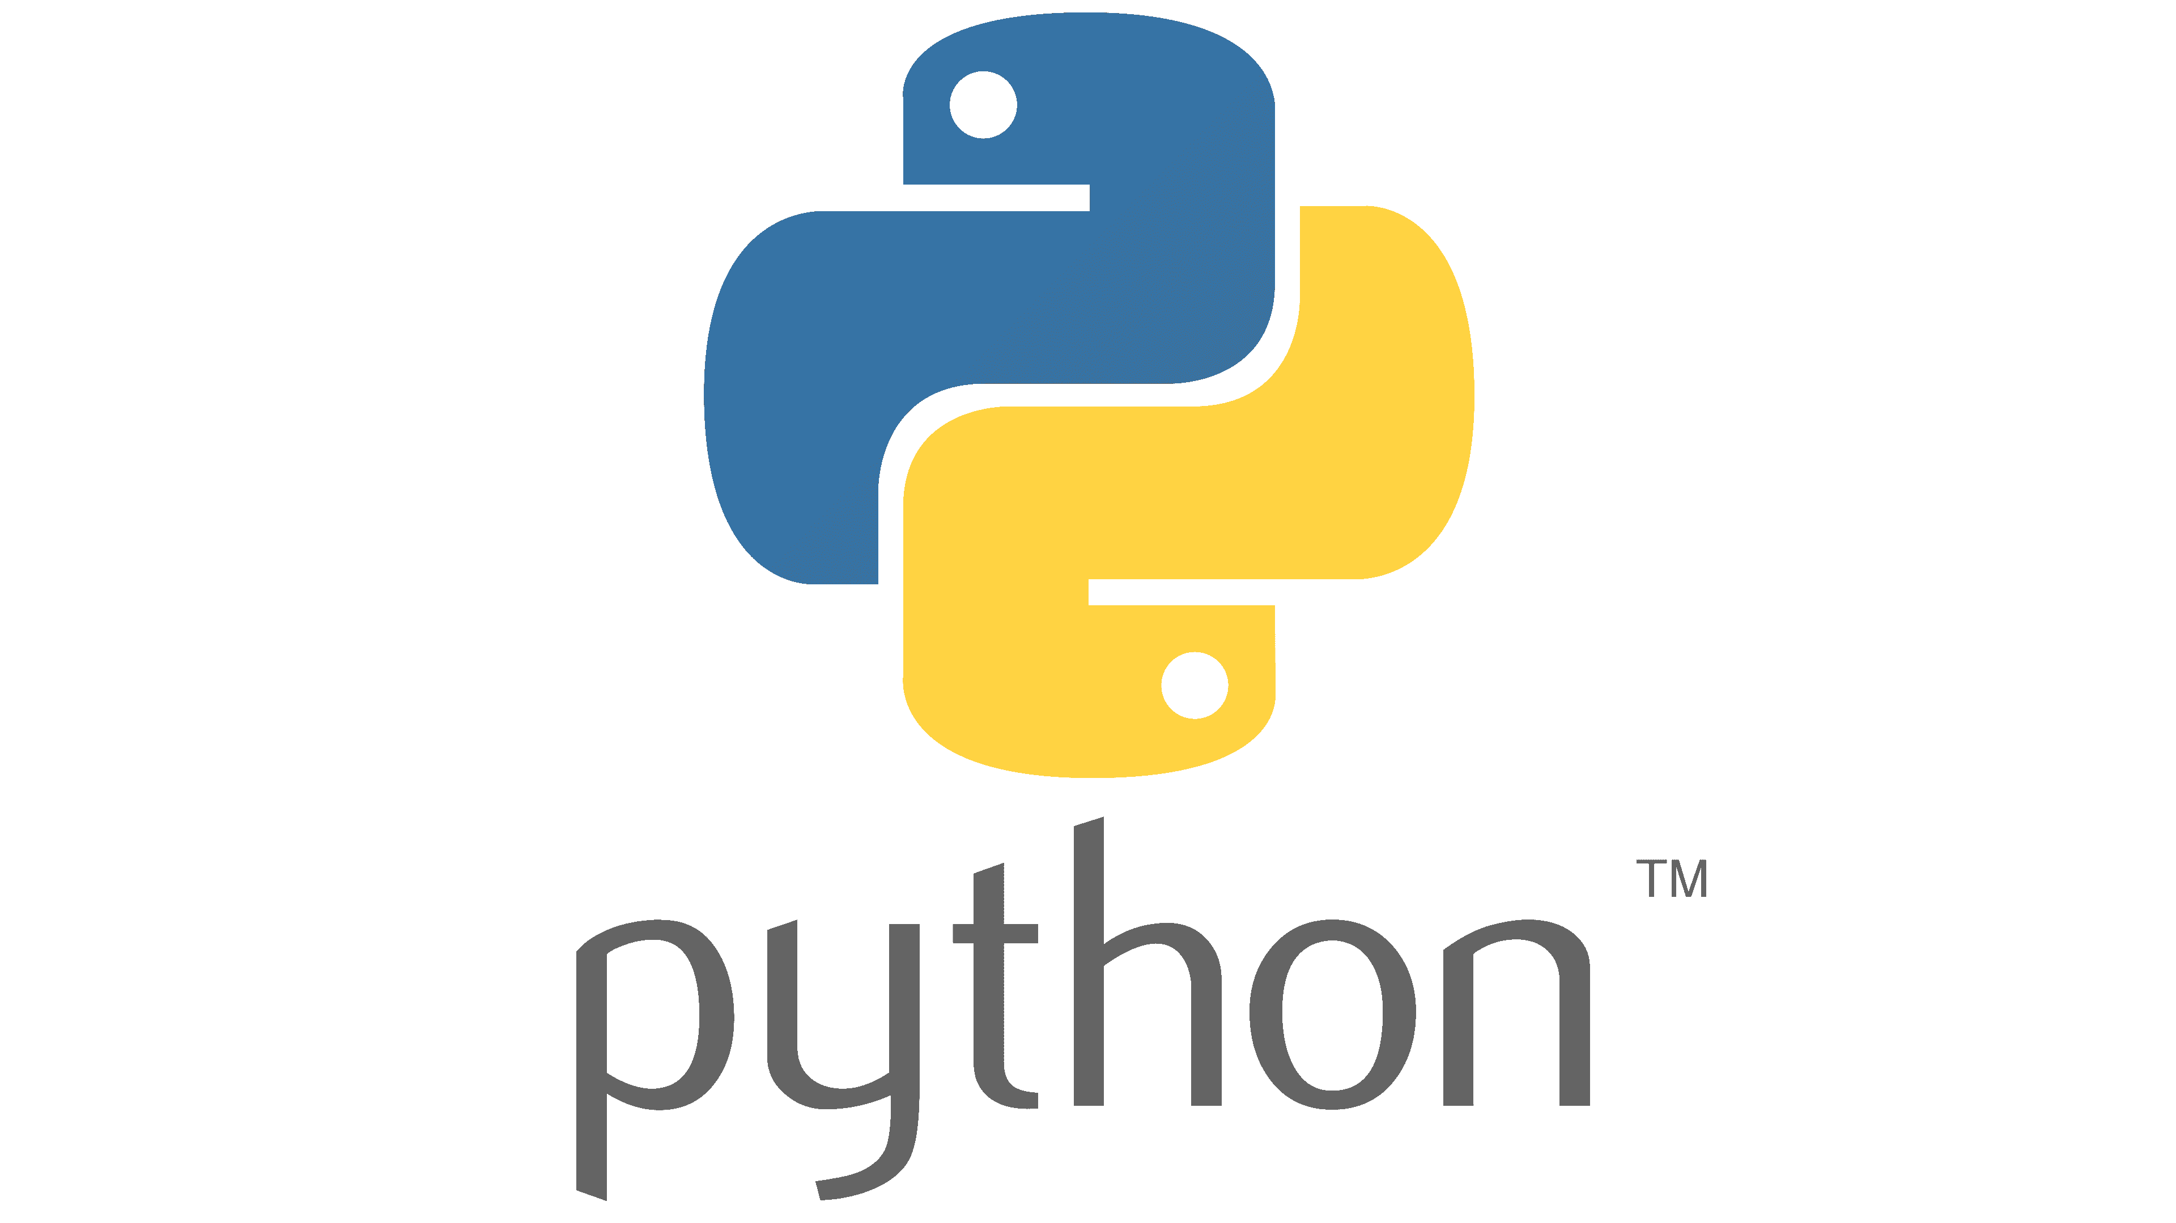
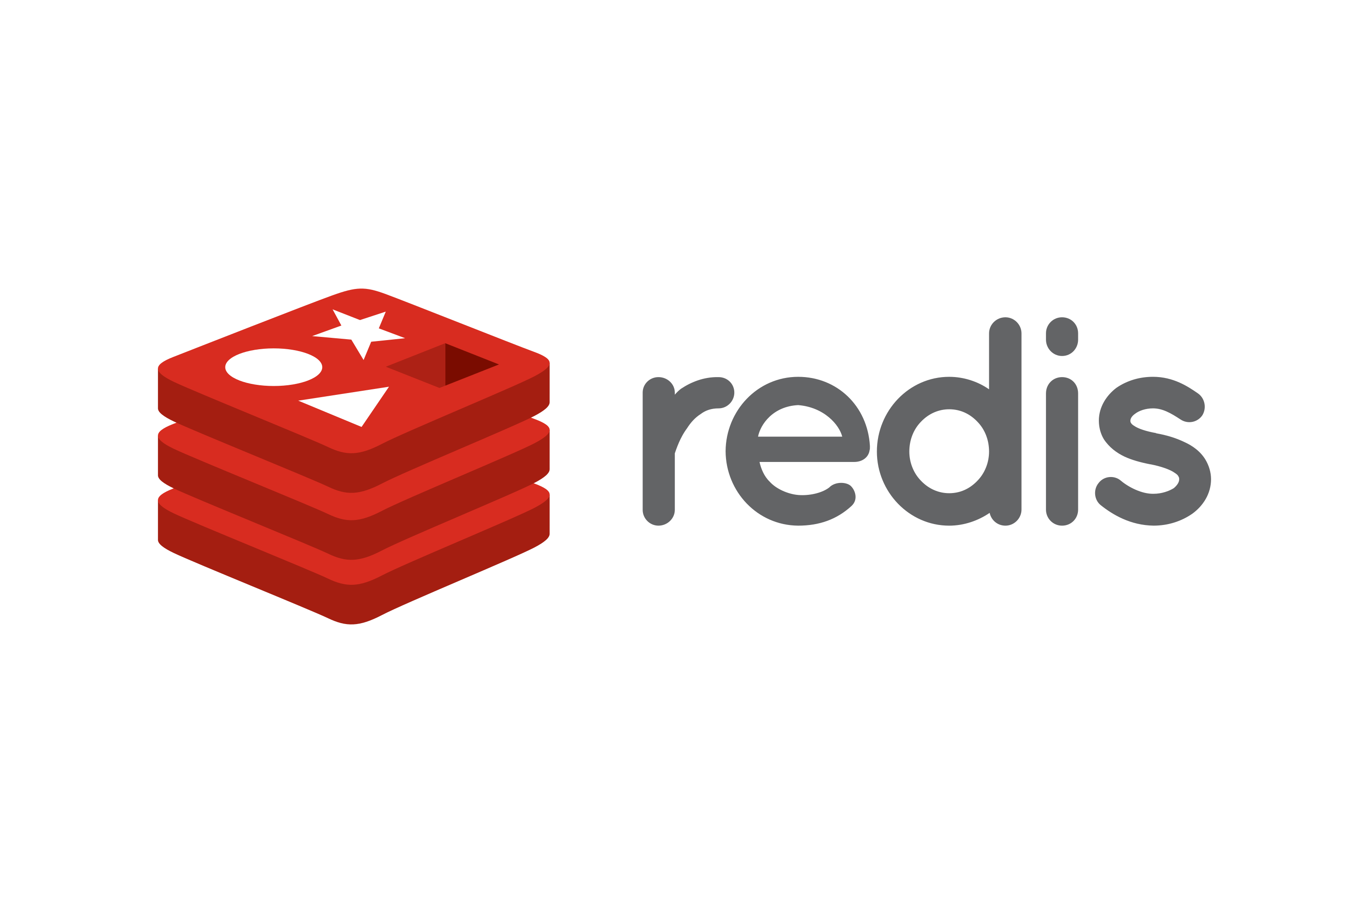

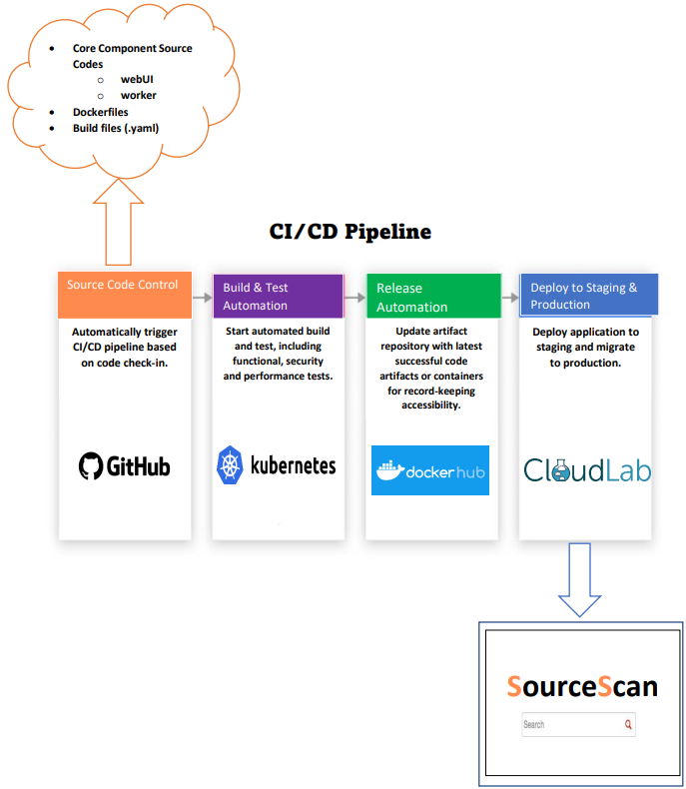
SourceScan
By: Sayo Ade-Oyetayo, David Desjardins, Jason Kost, Andrew Roche, Mayur Suresh
“A little under half (48%) of U.S. adults say they get news from social media” - Pew Research Center
We live in an age where information can be spread faster than ever before.
How do we know if this information is factual and where it is coming from?
That's why we built SourceScan!
A Cloud-based application that utilizes Docker to containerize its key components and deploy via Kubernetes pipeline.
How it works
First the client requests a search.
SourceScan will then gather the most popular posts from Reddit about the client's request (via Reddit API).
The deployment of the Kubernetes pipeline through Cloud Lab allows user to view top posts from that week and/or month.
SourceScan will then compare the Reddit posts to a pool of various news sources and determine if it's reliable and where the post got its information from.
All information is displayed on a user-friendly interface that makes SourceScan a quick and easy tool to use.
We’re not done yet!
There are still challenges ahead of us..
What we still need to accomplish:
Comple the front-end/user-interface.
This will allow for us to finish all build files, as well as completing the Kubernetes pipeline connection.
Integrate client-response scanner to Reddit API.
Ensuring all Docker files and containers are properly structured for a Kubernetes environment.
GitHub: https://github.com/MaySuresh/Group-8

